Slide 1
EVOLUTION OF IT AUTOMATIONS
WITH DEVOPS, SRE & AIOPS
Anwin Varghese
23-July-2022

Slide 2
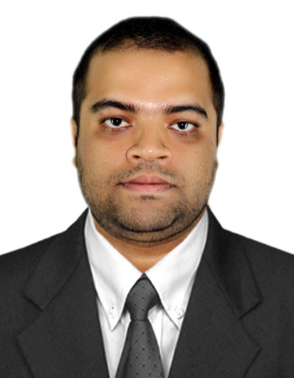
Speaker Introduction
IT professional based out of Bengaluru with over 12 years of progressive experience in Software Automation, DevOps, SRE & AIOps across top Fortune-500 companies like Target Corporation, Intel, JPMorgan Chase & Wells Fargo.
MS (Computer Science), MPhil (Computer Science), MBA (Executive) from Christ University, Bengaluru. currently pursuing MTech (Artificial Intelligence & Data Science) from IIIT-Kottayam.
Experience in several Automation & AIOps implementations in the Fintech & Banking domain.
Anwin Varghese

Slide 3
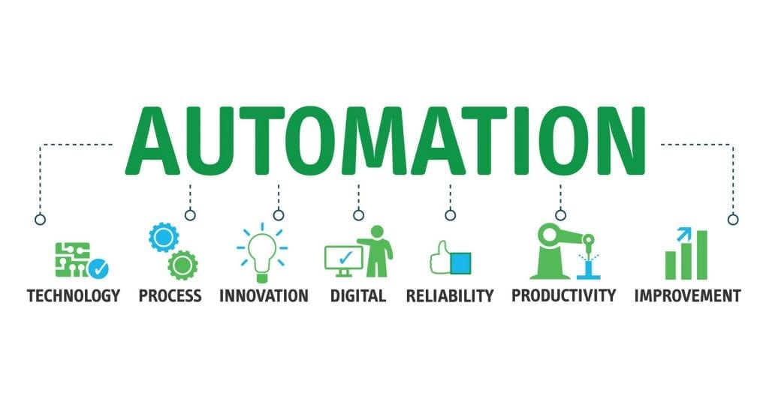
Contents
Software & Automations Timeline
DevOps & SRE
ITOps
AIOps
AIOps Capabilities
Tools Ecosystem
AIOPs Use cases
Data Selection Use Case
Pattern Discovery Use case
Inference Use case
Collaboration Use case
Automation Use case
AIOps Impact
Q&A
Datasets
Sources

Slide 4
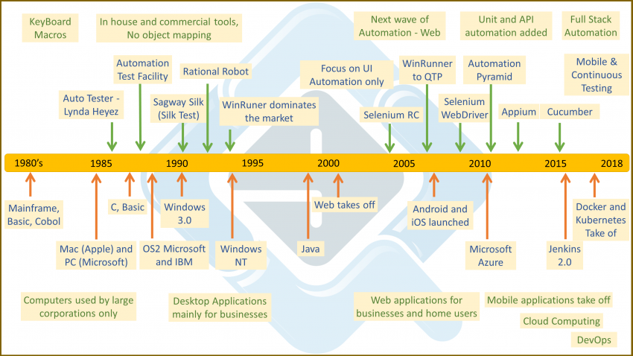
Software & Automations Evolution

Slide 5
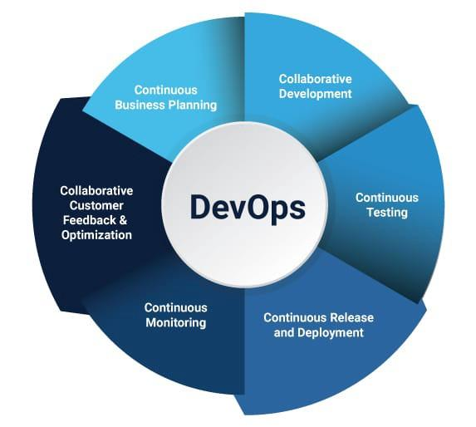
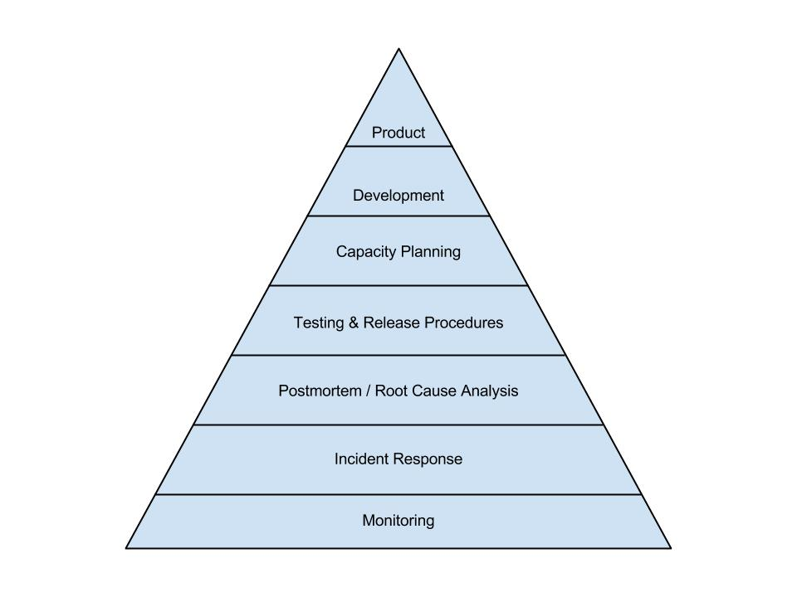
DevOps & SRE
 | DevOps | SRE
Essence | Mindset & Culture of Collaboration | Set of Practices & Metrics
Coined | In 2009, Patrick Debois, IT Consultant | In 2003, Ben Treynor of Google
Focus | Improve Business Value through Continuity in Speed of Product Development and Delivery. | Improve Customer Experience - System Availability, Reliability, Stability, Event Management & Toil Automations.
Metrics | Time to market, Velocity | MTTR, SLI, SLO, SLA, RCA

Slide 6
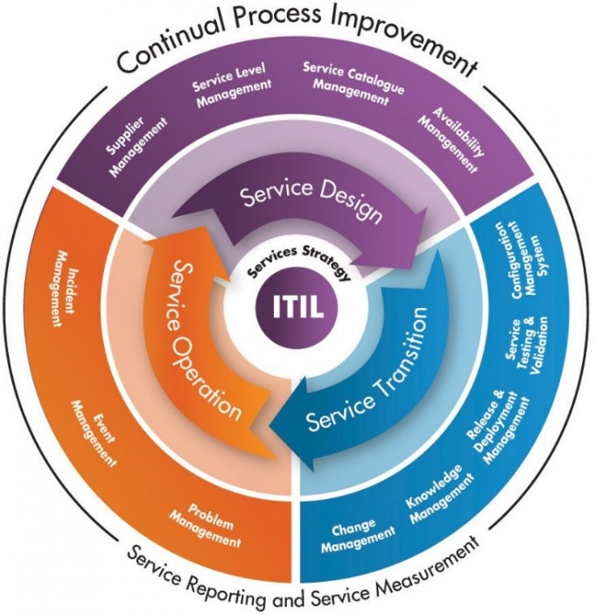
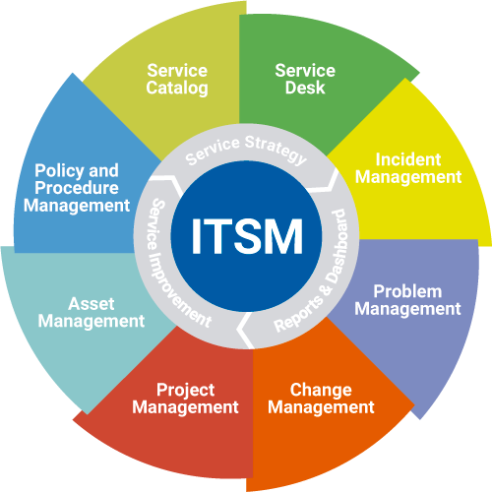
ITOps
ITOps ensures that there are no interruptions to IT services. ITOps takes care of deployment, maintenance, configuration, and monitoring of all the physical and software components of a company’s IT environment.
Pillars of ITOps
ITIL
ITSM
ITOps
Application/Product Ops
Infra Ops - Server, Network, DB
Platform Ops - Cloud
Cyber Ops - Security

Slide 7
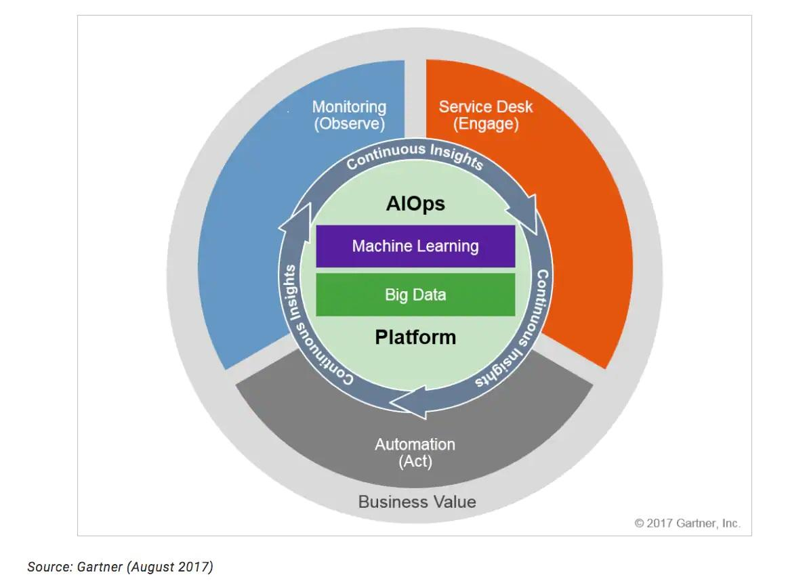
AIOps
AIOps is the application of AI to ITOps. AIOps combines Big Data and Machine Learning to automate ITOps - Monitoring, Service Desk & Automation.
According to a study by Digital Enterprise Journal (DEJ)
There has been an 83% increase in organizations deploying or looking to deploy AIOps capabilities
Out of those, 65% were actually adopting AIOPS

Slide 8
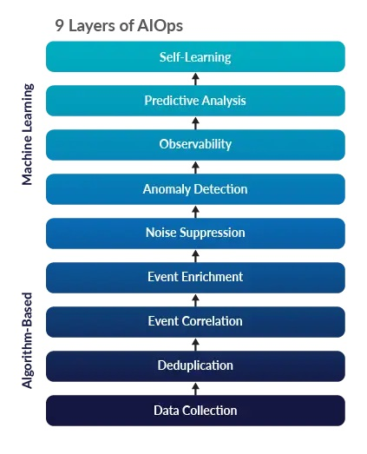
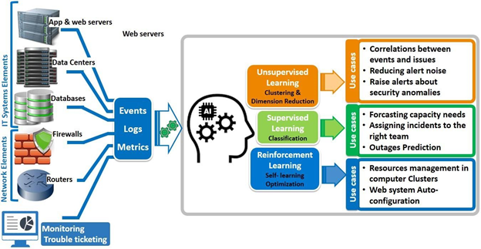
AIOps Capabilities

Slide 9
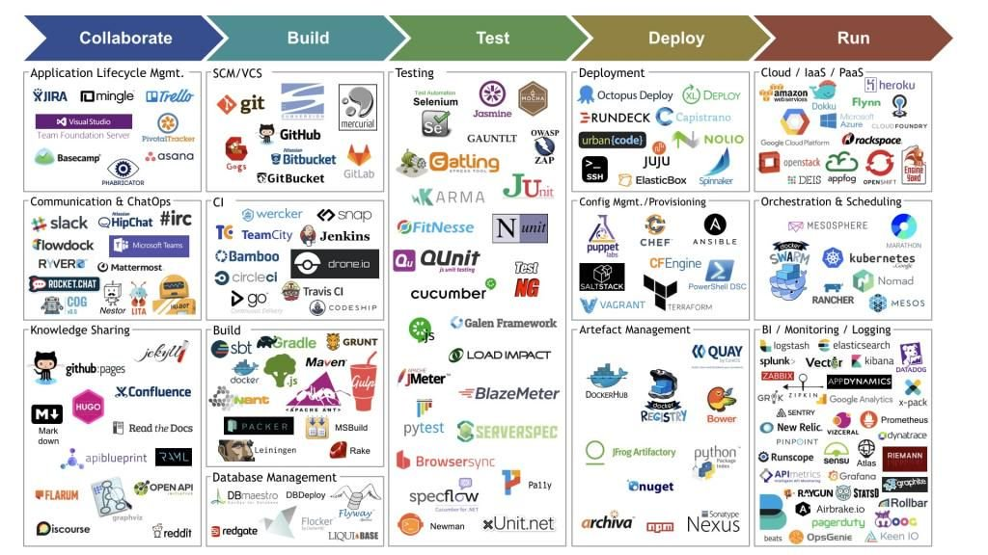
Tools Ecosystem

Slide 10
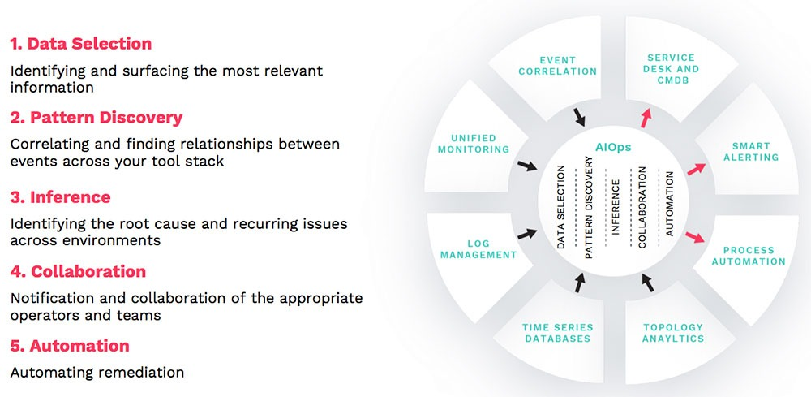
AIOps Use cases

Slide 11
Data Selection Use Case
IT Service Desk receives a lot of calls/tickets. However, organizations always are keen to optimize the Ops costs.
What do we do?
Outsource to third party
Automations (Process, People, Technology)
Which vendor to select? What to automate? What are the top Call Drivers?
AIOps
Data selection - Identify top call driver by ticket categorizations through text based analytics
Self learning - Identify the clients/vendors as per certain parameters
Benefits -
Identify the top call drivers to target remediations
Identify clients/vendors for selecting right performers
Example - ServiceNow (ITSM) tickets categorizations & Clients selection - NLP, NLTK, Spacy models.

Slide 12
Pattern Discovery Use Case
Inevitably, any organization face IT downtime - resources or services. However, organizations desire early & timely resolutions.
What do we do?
Monitoring & Event Management Solution for Early issue detection
Business Continuity Plans (BCP) - Backup, High Availability (HA), Disaster Recovery (DR)
Which related events occurring at similar time are affected? How quick can we identify problem area & recover?
AIOps
Events aggregation, enrichment, correlation and pattern discovery - Timestamp or CI Identity.
Anomaly detection - Spam Emails, log analysis, Live Visualizations of the important metrics & indicators.
Workflow management executing remediations - desired state, scaling, Backup/HA/DR/ execution
Social media sentiment Analysis
Benefits -
Faster acknowledgement, resolution & recovery time (MTTR).
Early remediations put in place by pinpointing the exact problem area.
Save on penalty/fine amount to be paid for service unavailability.
Example - Observability Pipeline, Downdetector reporting social media sentiments to correlate with internal IT. O365, Splunk

Slide 13
Inference Use Case
Often IT Ops face repeated incidents of similar nature and this would be due to an underlying undetected problem. Organizations would have a remediation in place but definitely desire to detect & fix the problem so that incidents aren’t reported.
What do we do?
Deduplication & Clustering
Root Cause Analysis, Post-Mortems
What CIs are affected? What incidents can be identified as similar?
AIOps
Synthetic Transaction Monitoring & Incidents Clustering
Related topology mapping of affected CIs - downstream/upstream & CIs with health, infra metrics.
Benefits -
Deduplication helps in reduced incident volume.
Lower risk of new incidents due to existing underlying undetected problem & discover undetected problems.
Blameless post-mortems.
Example - Apica (synthetic testing), Service Now (CMDB), Splunk (log analysis) & BigPanda Tool (deduplication)

Slide 14
Collaboration Use Case
IT Service Management requires multi-team collaborations - Major Incident Management, High Risk Change Management or DR Drill. Organizations are keen to optimally engage the resources & employees.
What do we do?
Multiple shifts - 24/7, 24/5, 16/5 or Follow the Sun model
Hand-off meetings & On Call
Which teams need to be collaborating? What Collaboration tools
AIOps
Configuration management database (CMDB) of all IT assets including employees
Automated communication for collaboration
Communication to concerned stakeholders.
Benefits -
Faster Acknowledgement & Remediation plans - reduced collaboration costs.
Efficient Management & Communication.
Improved Goodwill (Customers & Employees)
Example - Everbridge AIOps (Secure Communications CMDB), O365 (Office 365 productivity suite)

Slide 15
Automation Use Case
Organizations are keen to automate IT Ops process, issue remediations, Ops workflows.
What do we do?
Standardizations - ITIL, ITSM
Develop Scripts/Workflows for Automations
Benefits -
Reduced manually ticket volume
Reduced process time.
Employees can work on items generating business value.
AIOps
ChatOps based automations.
RPA based automations.
Automated CMDB updates, assets & access provisioning.
Example - Amelia/Assistant triggering automations, RPA automation suites, Workday - virtual joining

Slide 16
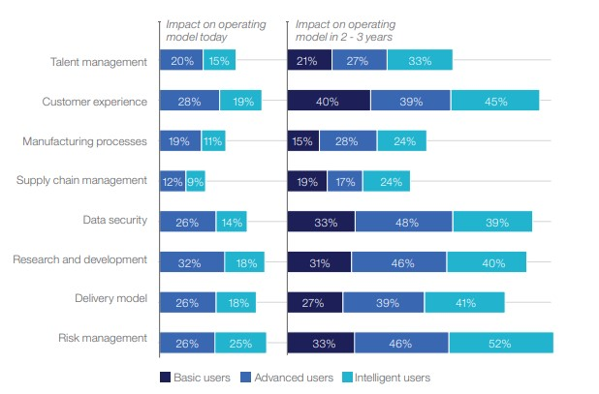
AIOps Impact

Slide 17
Q&A

Slide 18
Sources
https://www.iaasiaonline.com/wp-content/uploads/SCHNEIDERELECTRIC2-1024x540.jpg
https://sdtimes.com/wp-content/uploads/2017/06/DevOps-Marketplace-Infinity-Loop.png
https://miro.medium.com/max/1146/0*DZCYh73o2j86uCvC.jpg
https://devopedia.org/images/article/54/7582.1513404307.jpg
https://devopedia.org/images/article/54/3352.1513404344.jpg
https://assets.david-merrick.com/2017/06/26/dickersons_hierarchy.jpg
https://www.srepath.com/wp-content/uploads/SRE-maturity-model-part-1-768x1006.jpg
https://www.keyfactor.com/wp-content/uploads/ms1a-680x703-1.jpg
https://qphs.fs.quoracdn.net/main-qimg-e8a776bf43c7e01ad1da3276d4c41045
https://www.splunk.com/content/dam/splunk-blogs/images/2017/11/AIOps.png
https://community.nasscom.in/sites/default/files/inline-images/AIOps-ISL-Service.png
https://resolve.io/imager/images/Integrations/46264/Resolve-Integrations-0720_d41d8cd98f00b204e9800998ecf8427e.png
https://www.moogsoft.com/wp-content/uploads/2020/06/fpo5dimensions.jpg

